Slide 1
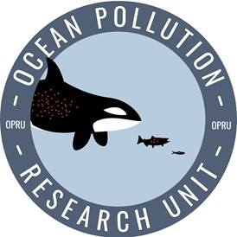
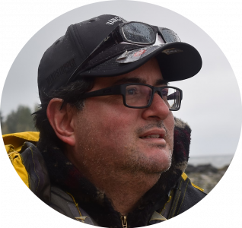
UBC Fisheries Economics Research Unit,
UBC-OPRU
Prof. U. Rashid Sumaila
Dr. Vicky Lam
Dr. Juan J. Alava
Main Research Theme:
Impacts of Climate Change, Overfishing and Pollution in Fisheries: A Risk Management and Solution Policy Framework.
Dr. Ibrahim Issifu
i.issifu@oceans.ubc.ca

Slide 2
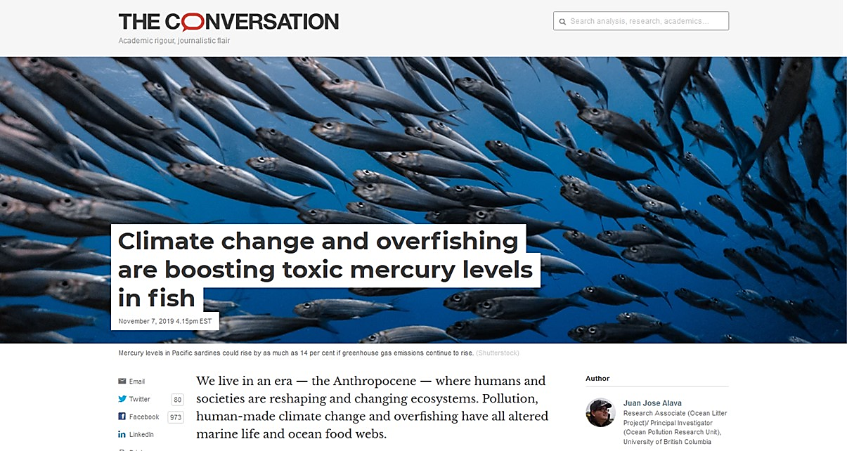
Weight of Evidence

Slide 3
40% of the world's oceans are heavily impacted by human activities, such as overfishing and pollution, study says
Eastern Caribbean
The North Sea
The Japanese water
The Torres Strait
A Global Map of Human Impact on Marine ecosystem
Source: Halpern, et al. (2008). Science.

Slide 4
Overfishing and fisheries decline - Review
Fig. 1: Trajectories of reported and reconstructed marine fisheries catches
1950-2010
Fig. 2: Northwest Atlantic
Reconstructed catch
Reported catch
Source: Pauly & Zeller (2016). Nature Communications

Slide 5
Percentage change in fisheries Maximum Revenue Potential is mapped against Human Development Index (HDI) of countries under high CO₂ emission scenarios (RCP8.5) by 2050.
Note: The bigger the size of the bubble the larger the percentage of economic impact of the fisheries sector to the total Gross Domestic Product.
Source: Lam et al. (2016). Sci. Rep.

Slide 6
Climate change-overfishing-pollution assessment framework
Anthropogenic
climate change
temperature driven change in oceans conditions:
>sea surface temperature (SST)
<pH
<Dissolved oxygen (DO),
<>Primary production (PP)
Overfishing/ IUU fisheries
Risk for marine fisheries, food-webs, and ecosystem resilience
Chemical & Biological Pollutants

Slide 7
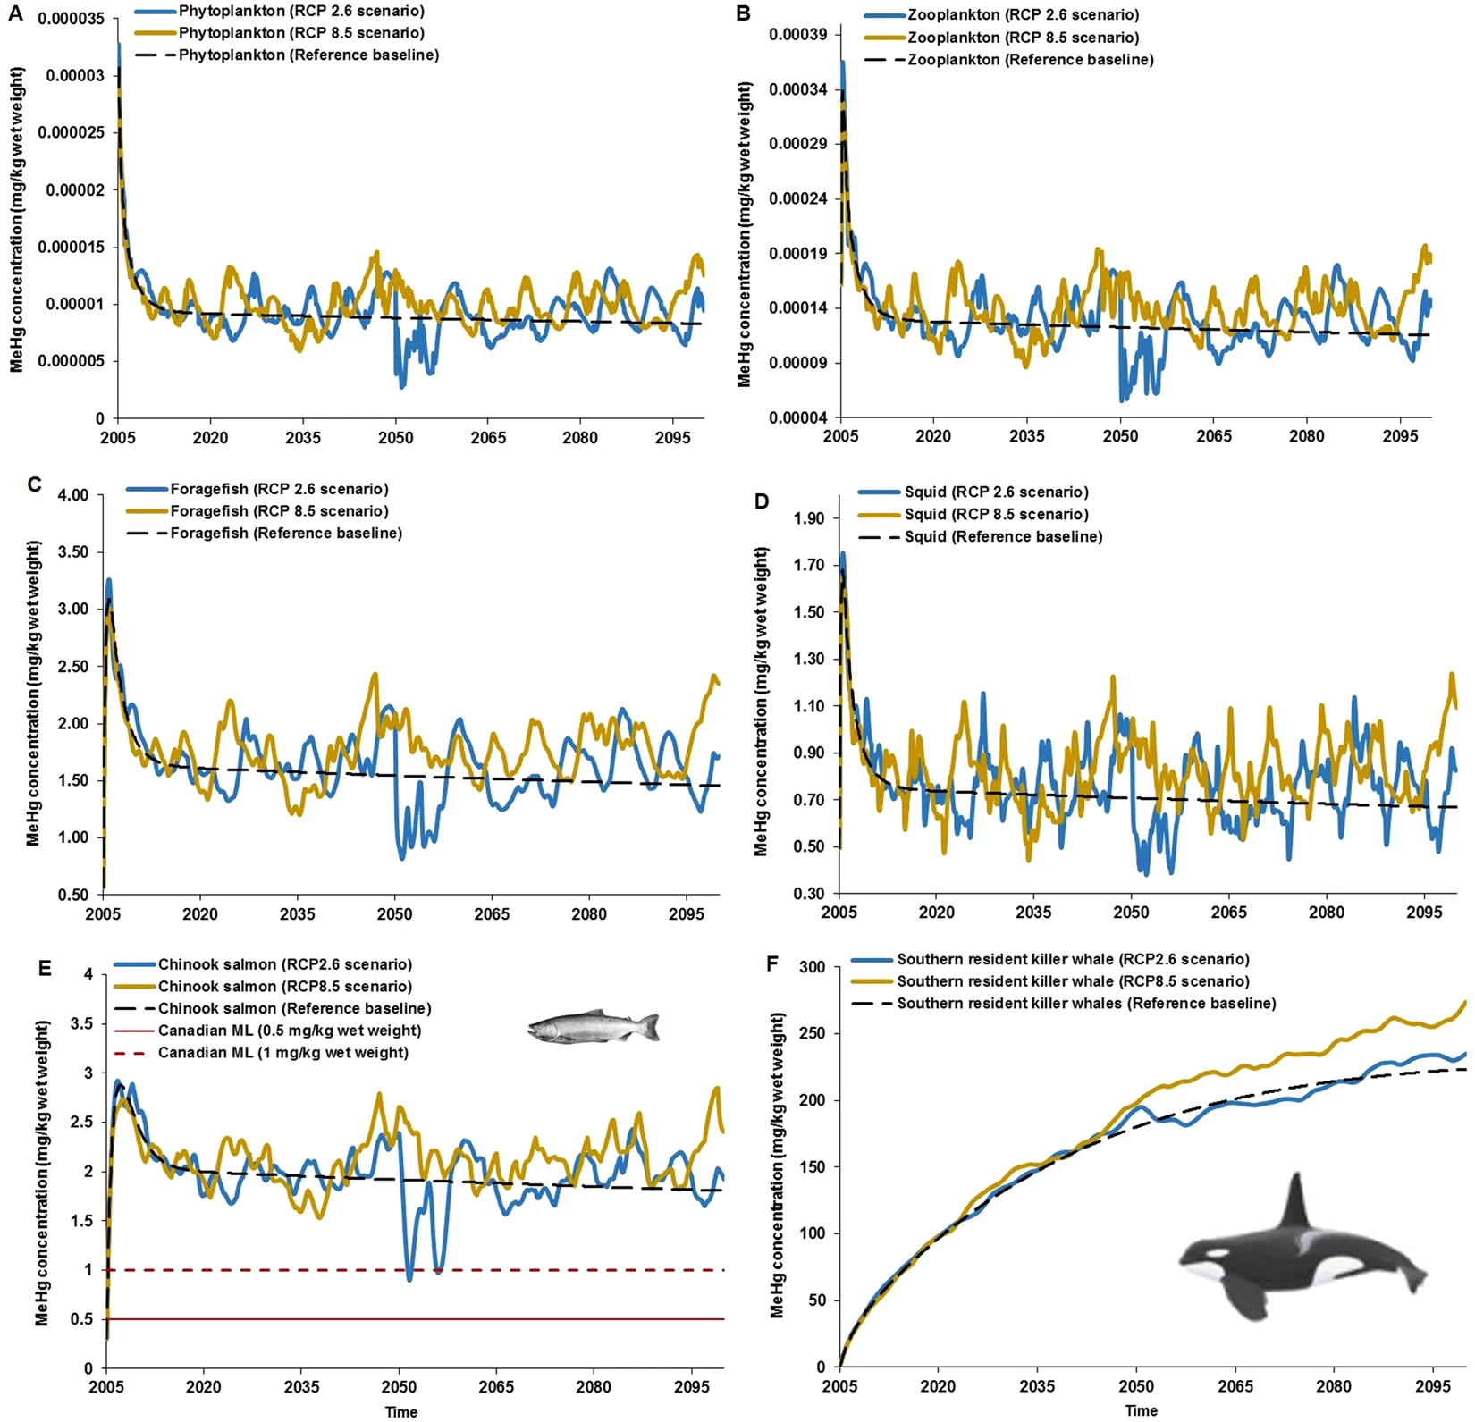
Projected amplification of bioaccumulation of organic mercury (i.e. methyl mercury, MeHg) in the marine food web under climate change scenarios in the Northeastern Pacific
RCP 8.5: business as usual (High CO2 emissions)
RCP 2.6: mitigation scenario (Low CO2 emissions)
Reference baseline (no CO2 emissions)
Alava et al. (2018) Scientific Reports

Slide 8
Adaptation of an assessment framework on climate change-pollutant interactions and impacts
Source: IPCC 2019
(SROCC: Chapter 5, Changing Ocean, Marine Ecosystems, and Dependent Communities

Slide 9
Global & regional climate change
(climate change-induced
pollution & overfishing sensitivity)
Global & local ocean pollution
(pollution-induced climate change sensitivity)
Overfishing: Illegal, Unreported & Unregulated Fisheries
(overfishing-induced pollution & climate change sensitivity)
Sensitivity/Vulnerability responses by marine biota/commercial species & foodwebs:
Shrinking of fish size
Collapsing of fish stocks
Changes in foodweb composition/structure
Changes in trophic transfer pathways
Increases of pollutant exposures in fish species
Exacerbation of foodwebs’ contaminant bioaccumulation
Risks
↓ Ecosystems health & resilience impacts
↓ Fisheries health/rehabilitation impacts
↓ Public health impacts
↓ Socio-economic impacts
Multiple-stressors’ interactions & impacts Framework

Slide 10
Universal policy pathways to mitigate, reduce and eliminate overfishing, fossil fuel emissions and pollution risks with associated impacts
Preventive/Precautionary Principle Approach:
Proactive & prevention approach (“Prevention is better than cure”)
Bottom-up policy based on community-based conservation/perceptions
Market-based instruments
Fisheries & ecotourism incentives/”good subsidies”
Pollution-free initiative and Eco-fees
Implementing sustainable green energy alternatives (carbon-free economy/decarbonization)
Command & Control/Reactive Approach:
Status quo or BAU (end-of-the pipe or “fire fighter” approach)
Top-down policy imposed by governments and authorities
Carbon taxes
Municipal regulations & emission controls
Permits/environmental violations fines and penalties
Versus

Slide 11
Preventive/precautionary principle pathway
vs
Command & control pathway
Mitigate Global & regional climate change
Control & Eliminate
Global & local ocean pollution
Ending Overfishing:
Illegal, Unreported & Unregulated Fisheries
Prevent sensitivity/Vulnerability responses by marine biota/commercial species & foodwebs:
Shrinking of fish size
Collapsing of fish stocks
Changes in foodweb composition/structure
Changes in trophic transfer pathways
Increases of pollutant exposures in fish species
Exacerbation of foodwebs’ contaminant bioaccumulation
Reduce & Avoid Risks
↑ Ecosystems health & resilience impacts
↑ Fisheries
health/rehabilitation impacts
↑ Public health impacts
↑ Socio-economic impacts
Policy Pathways Framework to eliminate and mitigate anthropogenic stressors

Slide 12
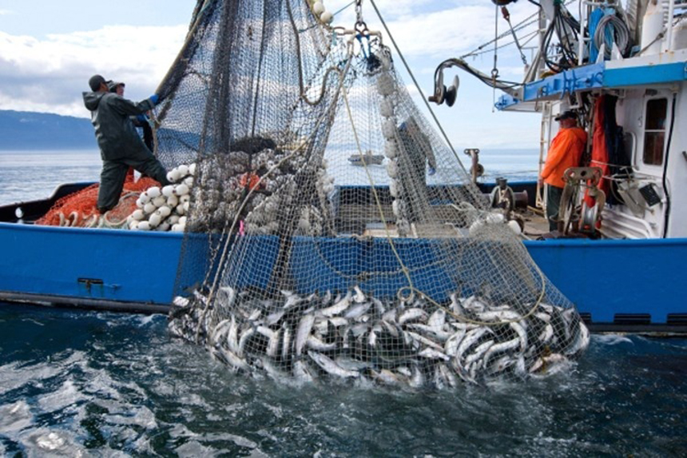
Policy & decision making (Ocean solutions triangle)
Preventive approach
Overfishing
CO₂
Control & command
approach
Market-based
approach
Incentive
Pollution

Slide 13
Next step: Modelling climate change, overfishing and pollution
Dynamic Bioclimate Envelope Model (DBEM)
Fishing data: http://www.seaaroundus.org
Climate change data: IPCC
Pollution data: Global dataset, for instance, mercury data

Slide 14
FERU
OPRU
Ibrahim
Vicky
Juan Jose
Rashid

Slide 15
Working for ocean resilience, works for you.

